Slide 1
Games Galore
OMLA 2012 State Conference
Michelle Koussa
Independence Middle School
mkoussa@independence.k12.oh.us

Slide 2
Goal…
The goal of this session is to provide you with examples of board games, computer games, and hand made games that can be used in your classroom.

Slide 3
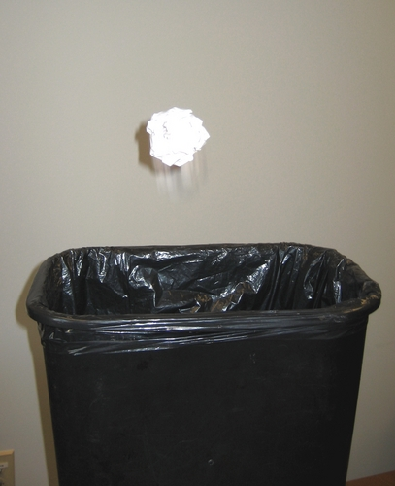
Trash Ball
Materials
Trash can, ball, tape, ?’s
Directions
Set up a trash can in an open area of the room. Place 1-? Pieces of tape in increments of 1 foot away from the can. Each tape line will be worth 1 point. Divide your students up into team. Call 1 member from the 1st team up to answer a question. If he/she gets it correct 1 pt. is earned and he/she can shoot for extra points by choosing a line of tape to stand behind. If he/she gets it wrong the next team can steal. You can play as many questions as you like or until a certain amount of points are reached. You can also create you own rules to deduct points for shouting answers out of turn, etc…

Slide 4
Smack!
Materials
Flyswatter, overhead
Directions
Chalkboard Version: Draw a BIG fly on the board. Divide the class into 2 teams. Call 1 person up from each team and read them a question. The first one to smack the fly with their swatter gets to answer for a point. You can also give each person a piece of chalk, have them write the answer on the board, and then smack the fly when they are done to see who gets the point.
Overhead Version: Call 1 person from each team up to answer a question. Post a question on the overhead. The first person to swat the correct answer on the screen gets a point.
*Printed vocab. game cards taken from http://jc-schools.net/tutorials/vocab/flyswatter.htm

Slide 5
Beach Ball Trivia
Materials
Beach ball
Directions
Write a variety of topics, questions, or numbers that correlate to a question all over a beach ball. Toss the ball around the room and the student who catches the ball must answer the question under or closest to their right thumb.

Slide 6
Times Table Football
Materials
overhead projector or chalk/white board, flash cards
Directions
Create field of play using the overhead projector. Create a deck of cards with times tables on one side. On the back of each card, place the answer, along with the results of a football play (e.g. 25 yard pass to wide out, 3 yard run by fullback, Incomplete pass, Fumble - lose 5 yards). The deck should have about 100 cards. Most are good results, but some are bad to add some element of surprise.
Start on the 20 yard line at the beginning of the game, half, and after scores. On 4th down they may choose to try for a 1st down, punt (40 yards) or go for a field goal (must be at least on the 40 yard line). Extra points may be 1 point. (answer the next card correctly) or two points (answer the card and make at least 3 yards.) If during play, one player misses a times table, the other team gets a chance to answer it correctly. If they do, they recover the fumble and start with a first down.
Penalties can be assessed for not paying attention when it is not your turn, excessive talking, helping someone else, etc.
http://www.multiplication.com/classroom_games.htm

Slide 7
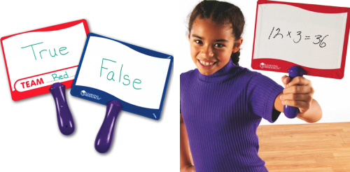
Team Trivia
Materials
Dry erase boards, dry erase markers, trivia ?’s
Directions
Divide up your class into teams. Give each team a board, marker, and Kleenex. Have each team come up with a name and write it on their board. Write the team names on the board where you can keep score. Read a question out loud and allow about 15-20 sec. for each team to write their answer on the board. You can use T/F, MC, vocab. Or short answer questions. Say “Times up, boards up!” Give one point to each team with a correct answer. Some questions I will make worth double or triple pts. depending on the content.

Slide 8
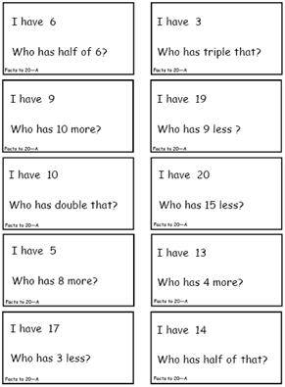
I Have…Who Has…
Materials
Index cards
Directions
On the top of an index card, write “I have” followed by a vocab. word. Then, at the bottom, write “Who has” followed by a definition that does not match the word above. Create as many cards as you would like, but make sure every vocab. word has a definition in the mix. Your last card should point back to the vocab. word on your 1st card. Shuffle the cards up and pass them out to the students. Have one person begin and read “Who has…” The person with the matching word will then read “I have…” and then continue the game.

Slide 9
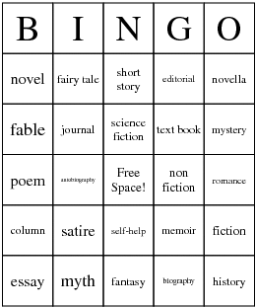
Bingo!
Materials
Boards, highlighters
Directions
This tried and true classic is always fun! Change the name Bingo and the spaces on your board to fit the theme of your book or unit. Have the boxes already filled in, or list the words at the bottom of the page and have your students randomly fill in each box. I always have the students tell me what each square means when they read a Bingo in order to get a prize. You can also play “human bingo” to teach physical and non-physical character traits or as a great team builder! Have the students get initials from other students in the class to get a bingo! Check out www.bingocardcreator.com/ to create free boards

Slide 10
“Wheel of Fortune”
You can order this wheel from Really Good Stuff: Reading, or create your own! You could also create a spinner.
This wheel works great for any type of questions, prizes, or game directions. Format the size and information in each space to fit your subject!
I use this in reading to talk about story elements, current events, and for our homework lottery! The kids love it!

Slide 11
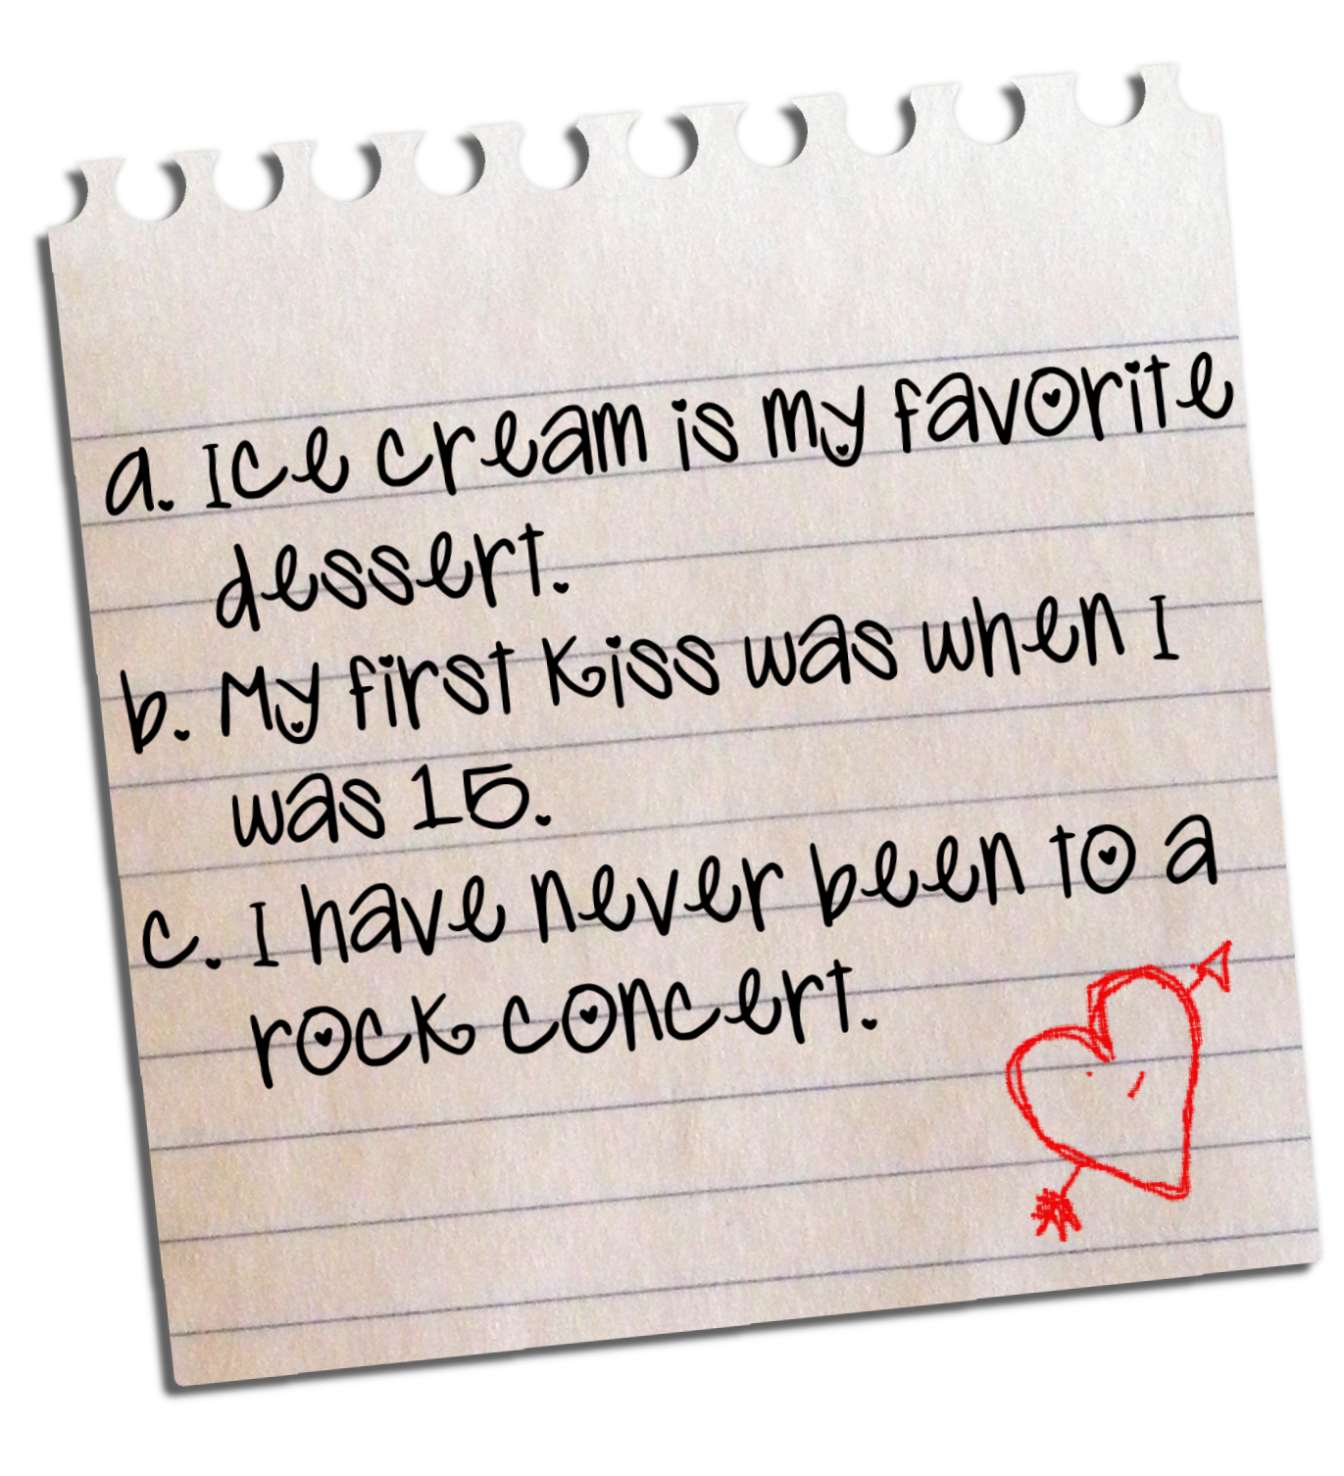
Two Truths and a Lie
Materials
Paper or note cards
Directions
This game is super easy to create and can be used to introduce or review information, or as a team building activity. Give the students a topic, such as “Ancient Rome, Electricity, Poetry, or yourself!” Then, have each student write 2 statements that are true and 1 statement that is a lie. Mix up the cards and pass them out. Have each student read the card out loud and as a class vote to decide which is the lie!

Slide 12
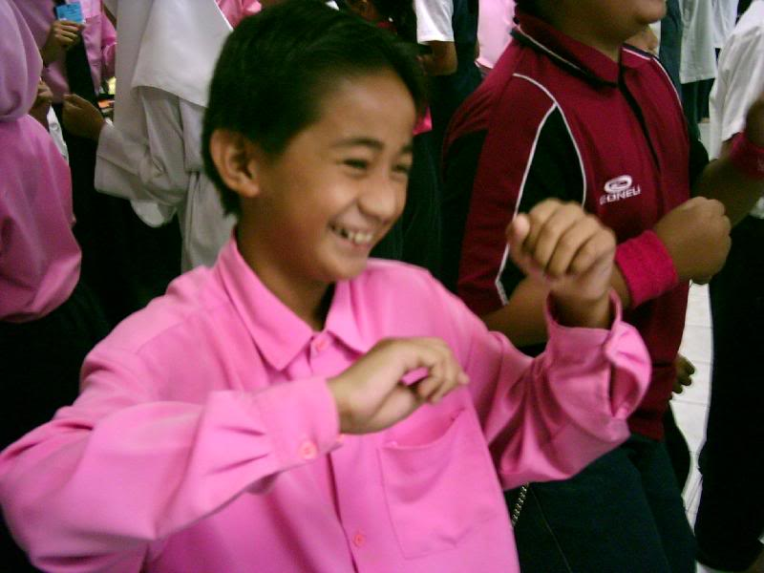
Somyuku
Directions
This is a great game to review math factors, divisibility, etc…
Have your students stand in a circle. The game starts by having everyone yell “Somyuko, Somyuku…Somyuko, Somyuko” all while flapping their arms like a chicken. Then go around the circle counting out loud. Any time a number ends in 3, 6, or 9 that person must clap and not say the number. If any student begins to say the number instead of or while clapping he or she is out. The next person in line begins the yelling, flapping, and counting at 1 again.

Slide 13
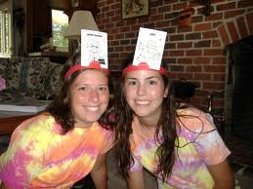
Guess Who?
Materials
Paper or note cards, string or tape
Directions
Use this as a review of vocab. words, people, places, events, or things. Write a topic/word on a piece of paper or note card. Tape one word card to the back of each student. Students must go around the room asking yes or no questions to discover who or what they are.
*You can also use headbands to put the word on your forehead. Make them out of cardboard/magnets.

Slide 14
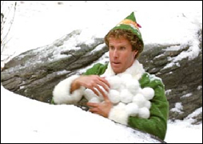
Snowball Fight!
Materials
Paper, garbage can, prizes (optional)
Directions
Students write a question on a piece of paper, crumple it up, and then have a snowball fight for 1 minute. Students grab a snowball and then take turns going around the circle and reading their question. If they get the question right they can shoot their snowball in the garbage can for a treat.

Slide 15
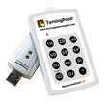
Turning Point
Materials
Turning Point Program/Clickers, Power Point
Use this program to create anticipation guides, entrance/exit questions, to review info, or as a short quiz. You can create slides in PowerPoint using Multiple Choice, True/False, short answer, or fill in questions. You can create class rosters and track individual results. This program can also be tied in and used with Study Island, Exam View, and other software. You can also purchase Response Ware through them which allows you to use cell phones, iPad’s, and computers to send answers.
http://www.turningtechnologies.com/

Slide 16
Board Games
The following slides contain popular board games that can you used in your classroom. Use the board game as is, or change the rules and questions to fit your needs! You can also have the kids redesign the questions/rules to fit the chapter or topic you are working with.

Slide 17
Scattergories
Give students a topic and have them brainstorm/write as many things that come to mind. You can have them make a general list or have them think up one thing for each letter of the alphabet. This is similar to brainstorming for a KWL chart, but a little more fun! Give students a set time to write down thoughts. Then, go around the room and have each student say one thing from their list. If anyone else in the class has the same thing written down they must cross it out. If a student writes down a word or thought that no one else in the class has, then they can circle it. The student with the most unique thoughts at the end wins! *This can often take a lot of time depending on the topic. You can adjust the rules accordingly or play at tables and have the kids share their lists together and cross out the words. You could then compile a class list of the top 5-10 words/thoughts.

Slide 18
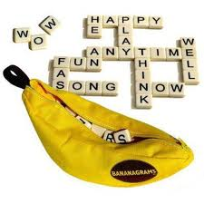
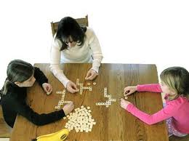
Bananagrams
Materials
Banagrams Game (1 per 11 students)
Directions
This popular game is similar to Scrabble, and can be used as a general vocab. builder, or to review key words and concepts on a particular book, chapter, or topic. Students take a select number of tiles based on how many people are playing and create their own crossword board of words based on the category you give them. When the game is over they must explain the definition of the words they chose! (Follow the rules of the game to peel, split, or be dubbed a rotten banana!)

Slide 19
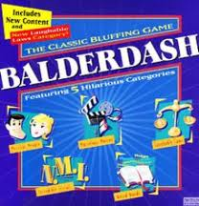
Balderdash
Materials
Game board (optional), paper
Directions
This is a great way to introduce new vocab. words. Write a new word on the board and have students write down what they think the definition is. While they are writing you need to write down the correct definition. Collect all of the definitions, read them aloud, and then have the students vote on which they think is the correct answer. If they guess the correct definition they get a point. If the definition they originally wrote is correct they automatically get 2 points! You can have students play individually or in teams to cut down on the # of definitions.

Slide 20
Other Popular Board Games…
Catch Phrase
Have students sit boy/girl in a circle to create a boys team and a girls team. Use the actual game as a general vocab. builder and select from the categories given (sports, history, geography, entertainment, food/drink, general). Students must describe the word given without saying the word. Each team guesses only when someone from their team is describing a word. Pass the game each time a word is guesses. Whoever is holding the game when time is up, the other team gets a point. You can also create this on your own and tailor it to your needs by creating a stack of note cards with one word on each cards. Set your own timer and have the students pass the stack of note cards around the circle, switching the card after each correct answer is guessed.
Pictionary: Practice visualizing or creating mental images based on words given.
Guesstures: Practice communicating words and ideas through non-verbal communication.
Monopoly: Have students keep a log and balance a checking account while playing.

Slide 21
Have students design and make their own board games!
These students created a game based on the book
The Egypt Game by Zilpha Keatley Snyder

Slide 22
Have students investigate popular board games to come up with criteria for a good board game. Use that criteria to have students create a rubric for the game they will create. Have them design the format, instructions, and game pieces!
Diary of a Wimpy Kid
The Egypt Game

Slide 23
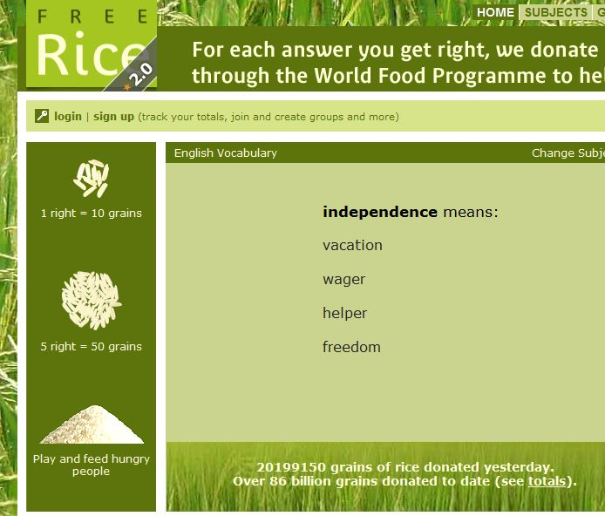
Online Games: Free Rice
Your students can practice vocabulary and save the world at the same time with this site! This site features categories ranging from vocabulary and grammar to geography and math. The vocabulary section has up to 60 levels of challenging words that your students can take on. When you enter the site you will begin with vocabulary. For each question you answer correctly, 10 grains of rice are donated to 3rd world countries. The program will increase or decrease your level based on your accuracy. There are links at the bottom of the screen to change levels or categories. Challenge your students to see who can reach the highest level or who can raise the most rice!
http://www.freerice.com/

Slide 24
www.freerice.com

Slide 25
Greek Root Word Olympics
Your students will compete in the Olympics while practicing Greek and Latin root words. When entering this site your student can enter their name, choose a country, and then choose to compete in archery (easy) or discus (hard). Then, they will go through a series of multiple choice questions dealing with root words. At the end of the round (10 questions) there is a medal ceremony and your students can print a medal of achievement!
http://teacher.scholastic.com/activities/athens_games/gamegreektome.htm

Slide 26
Online Games
Check out these sites for more great online games for all subjects:
http://www.funbrain.com/kidscenter.html
http://www.scholastic.com/kids/stacks/games/
http://pbskids.org/go/ (print to go!)
http://kids.nationalgeographic.com/kids/games/
http://www.playkidsgames.com/
http://www.mathplayground.com/
http://archive.k20center.org/applegate/My%20Web%20Page/Elementary.htm
(The one above gives a HUGE list of other online games and a description of each!)
www.quia.com
http://www.multiplication.com/classroom_games.htm

Slide 27
Popular Game Shows!
Check out this website where you can download free Power Point templates and put your own spin on the following popular game shows: Jeopardy, Who Wants to Be a Millionaire, Wheel of Fortune, Are you Smarter Than a Fifth Grader?, and Hollywood Squares. There are also tons of printable games!
http://jc-schools.net/tutorials/ppt-games/

Slide 28
A few resources…
Just a few books about games & fun classroom activities to check out:
1. 101 Great Classroom Games by Alexis Ludewig
2. Meet Me in the Middle by Rick Wormeli
3. Fire Up for Learning! By Randy Thompson & Dorothy VanderJagt
4. Index Card Games for ESL by Raymond Clark
5. Vocabulary Games for the Classroom by Robert Marzano
6. Fun with Grammar by Laura Sunley
7. Active Word Play by Jane Feber
8. The Nuts & Bolts of Active Learning by Incentive Publications
9. Quick & Lively Classroom Activities Book by Linda Nason McElherne
10. Playing to Learn: Video Games in the Classroom by David Hutchison

Slide 29
Questions ??????????
Contact me if you have any questions at:
Michelle Koussa
mkoussa@independence.k12.oh.us
216-642-5865 x1324
THANK YOU FOR YOUR TIME ☺

